Slide 1
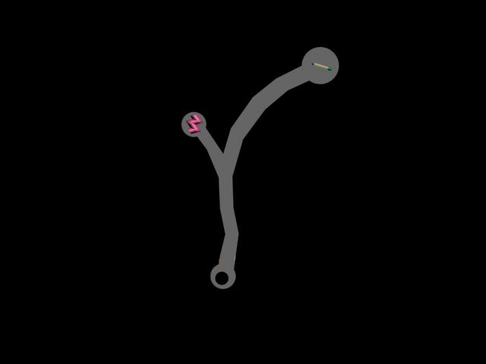
Some abandoned Cave….

Slide 2
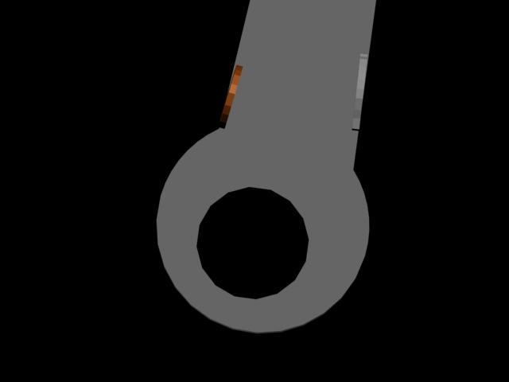
The first room…
supposed to be glass

Slide 3
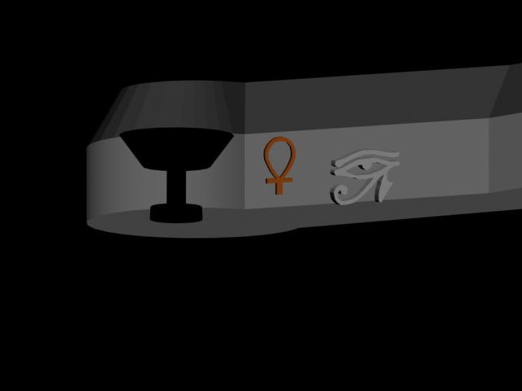
Another render of the same room…
What a nice black cup….

Slide 4
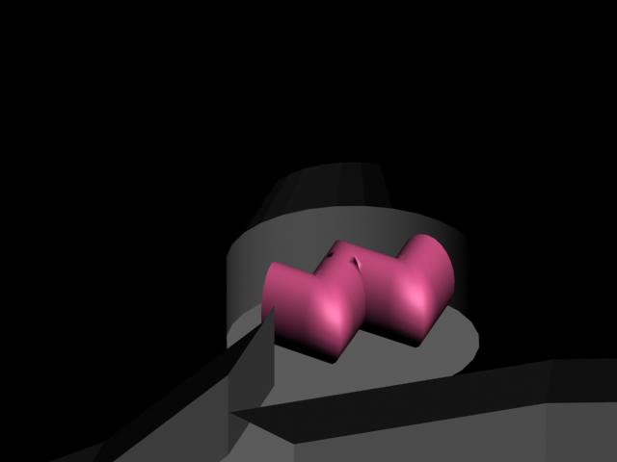
The utility room
A power source to power the cave, unfortunately it doesn’t work too well and can’t power the lights…

Slide 5
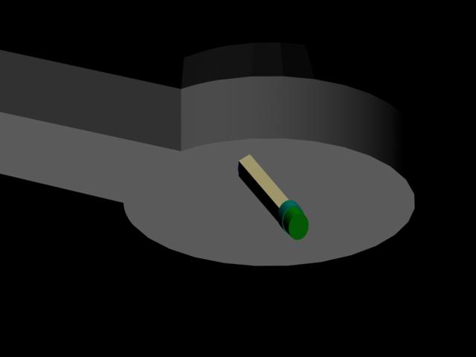
Weapons room…
Was supposed to be a pencil so you can fight your enemies with, but the cave was abandoned and the pencil diminished… or maybe it wasn’t sharpened…

